Slide 1
CS 211 Computer Architecture Lecture 5: Inside a Modern Computer System
Ravi Mittal
ravi.mittal@iitgoa.ac.in
Indian Institute of Technology, Goa

Slide 2
We will study today
What are the components inside a modern desktop?
GPU – Specification
Why do we need GPUs?

Slide 3
Today’s Thought
Do you listen?

Slide 4
Today’s Thought …. By J Krishamurti
“To be able to really listen, one should abandon or put aside all prejudices.
When you are in a receptive state of mind, things can be easily understood
But, unfortunately most of us listen through a screen of resistance.
We are screened with prejudices, whether religious or spiritual, psychological or scientific, or with daily worries, desires or fears.
And with these fears for a screen, we listen.
Therefore, we listen really to our own noise, our own sound, not to what is being said”

Slide 5
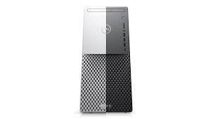
What is inside a modern Desktop?
Processors:
10th Gen Intel® Core™ i9-10900K processor(10-Core, 20M Cache, 3.7GHz to 5.3GHz) – 20 threads
Integrated GPU: Intel UHD Graphics 630
Discrete GPU: NVIDIA® GeForce® RTX 2070 SUPER™ 8GB GDDR6
Memory:
256GB M.2 PCIe NVMe Solid State Drive
2TB 7200 rpm 3.5" SATA Hard Drive
Intel Optane Memory - 32 GB, Storage Accelerator
DRAM: 128 GB, 4 x 32 GB, DDR4, 2666 MHz/2933 MHz, UDIMM, dual-channel
Chipset
DRAM Bus Width: 64-bits
Flash EPROM 32 MB
Computer Architecture

Slide 6
What is inside a modern Desktop?
Bus
Peripheral Component Interconnect Express (PCIe or PCI-E) – Gen 3.0
Network
Ethernet: 10/100/1000 Mbps
WLAN
WLAN: WiFi 802.11a/b/g
Wi-Fi 4 (WiFi 802.11n)
Wi-Fi 5 (WiFi 802.11ac)
Wi-Fi 6 (WiFi 802.11ax)
2.40 GHz/5 GHz
64-bit/128-bit WEP, AES-CCMP, TKIP
Bluetooth 5.1

Slide 7
What is inside a modern Desktop?
Ports: Seven USB 3.1 Gen 1 ports, Two USB 2.0 ports, One USB 3.1 Gen 1 (Type C), Headset port, RJ-45 port (Network), One audio line-out port, other sound ports
Sensors:
Air temperature sensor, Battery Sensor, Finger print sensor

Slide 8
What is inside a modern Desktop (Dell PC)?
Processors:
10th Gen Intel® Core™ i9-10900K processor(10-Core, 20M Cache, 3.7GHz to 5.3GHz) – 20 threads
Integrated GPU: Intel UHD Graphics 630
Discrete GPU: NVIDIA® GeForce® RTX 2070 SUPER™ 8GB GDDR6
Memory:
2TB 7200 rpm 3.5" SATA Hard Drive
256GB M.2 PCIe NVMe Solid State Drive
Intel Optane Memory - 32 GB, Storage Accelerator
128 GB, 4 x 32 GB, DDR4, 2666 MHz/2933 MHz, UDIMM, dual-channel
Chipset
DRAM Bus Width: 64-bits
Flash EPROM 32 MB

Slide 9
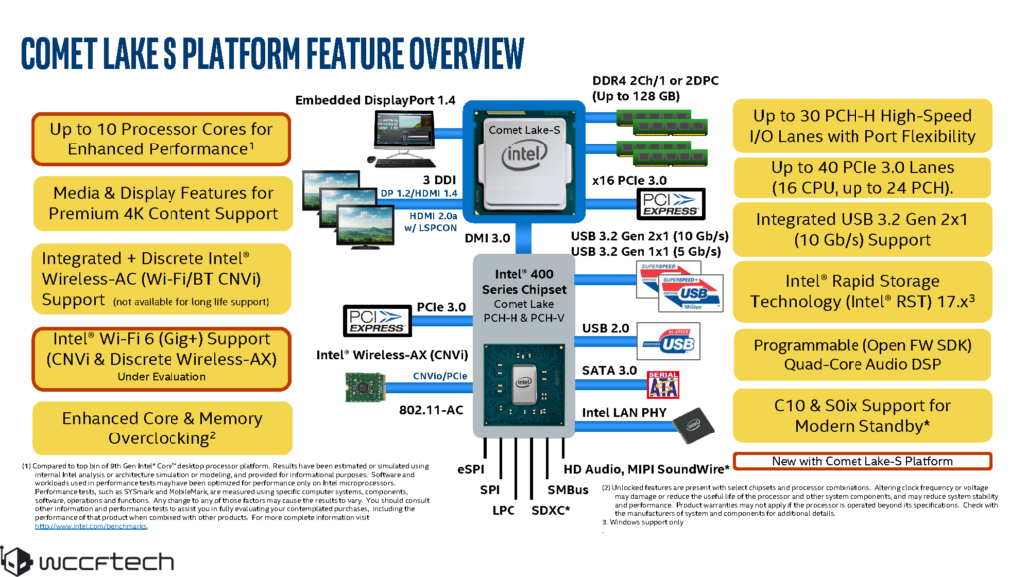
Intel’s 10 Core Core i9-10900K

Slide 10
Main Processor (1)
10th Gen Intel® Core™ i9-10900K processor(10-Core, 20M Cache, 3.7GHz to 5.3GHz) – 20 threads
Integrated GPU: Intel UHD Graphics 630
Number of cores: 10 ; Number of threads: 20
Homogeneous Cores ?
How does a programmer usesthese cores?
What is the role of OS in using cores?
How are the cores interconnected? Using bus ?
20 MB built-in cache
What is Cache Memory? How is it organized?
How many levels of Cache Memory? Why many levels of Cache?
L1 instruction cache, L1 data cache, L2 Cache, L3 Cache
Did you notice variable clock speed: 3.7GHz to 5.3GHz
Why do we need to change clock speed?

Slide 11
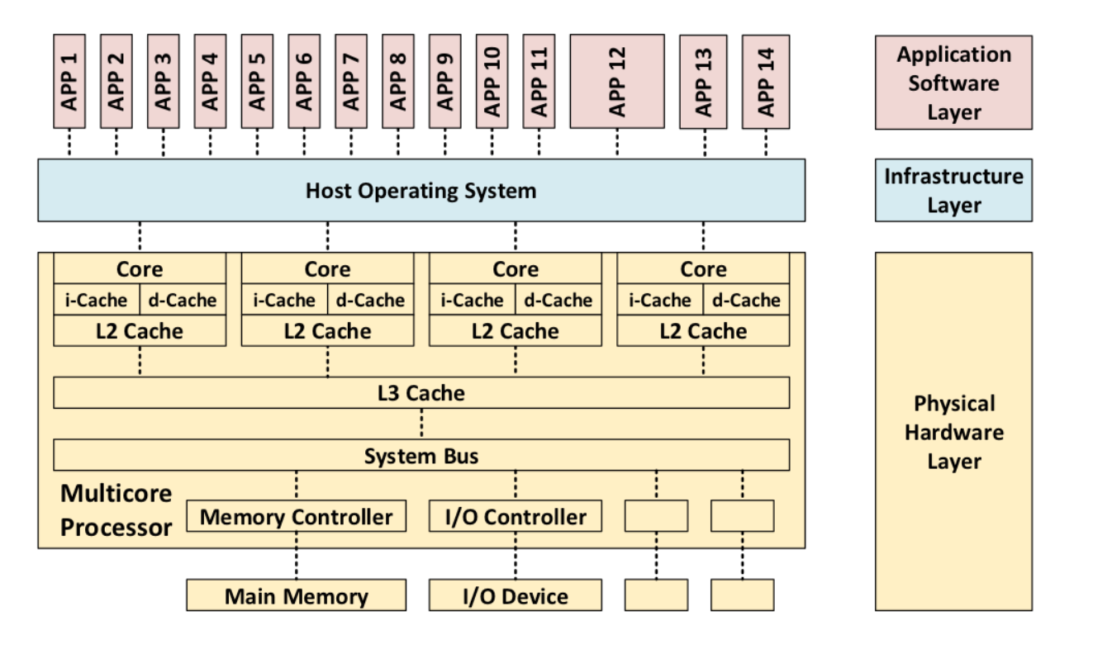
A quad-core Homogeneous Processor Architecture
See backup slides for Advantages and Disadvantages of Multicore processing

Slide 12
Main Processor (2)
Thermal Design Power (TDP) : 125 W
The average power, in watts, the processor dissipates when operating at Base Frequency with all cores active under an Intel-defined, high-complexity workload
Processor’s Base Frequency: 3.7 GHz
The processor base frequency is the operating point where TDP is defined
Max Turbo Frequency: 5.30 GHz
Max turbo frequency is the maximum single core frequency at which the processor is capable of operating
How to increase frequency of a processor ?
Use of Thermal Velocity Boost Feature - automatically increases clock frequency based on how much the processor is operating below its maximum temperature and whether turbo power budget is available
Depends on the workload, capabilities of the processor and the processor cooling solution
Can we increase frequency selectively on specific core ? Yes.

Slide 13
What is inside a modern Desktop?
Processors:
10th Gen Intel® Core™ i9-10900K processor(10-Core, 20M Cache, 3.7GHz to 5.3GHz) – 20 threads
Integrated GPU: Intel UHD Graphics 630
Discrete GPU: NVIDIA® GeForce® RTX 2070 SUPER™ 8GB GDDR6
Memory:
2TB 7200 rpm 3.5" SATA Hard Drive
256GB M.2 PCIe NVMe Solid State Drive
Intel Optane Memory - 32 GB, Storage Accelerator
128 GB, 4 x 32 GB, DDR4, 2666 MHz/2933 MHz, UDIMM, dual-channel
Chipset
DRAM Bus Width: 64-bits
Flash EPROM 32 MB

Slide 14
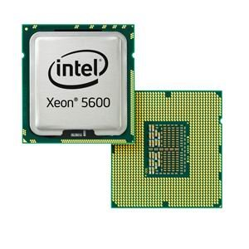
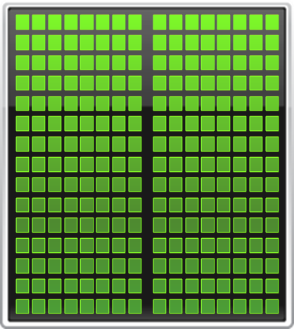
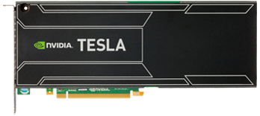


CPU
GPU
CPUs consist of a few cores optimized for serial processing and general purpose calculations.
GPUs consist of hundreds or thousands of smaller, efficient cores designed for parallel performance. The hardware is designed for specific calculations.
Notes:
Modern CPU's nowadays typically have 2 to 12 cores and are highly optimized for serial processing.
GPUs consist of hundreds or even thousands of smaller efficient cores designed for parallel processing

Slide 15
SCC GPU
SCC CPU
Intel Xeon E5-2680v4 :
64 cores
Memory size: 256 GB
Bandwidth: 76.8 GB/sec
NVIDIA Tesla P100:
3840 single precision cores
Memory size: 12GB total
Bandwidth: 549 GB/sec
SCC: Single Chip Cloud : Chip designed specially for parallel processing: based
on cloud datacenter architecture
Notes:
There is a significant difference in memory size and bandwidth that should be taken into account while deciding where to perform the calculations.

Slide 16
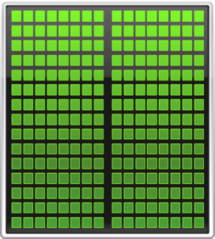
Minimum Change, Big Speed-up
Application Code
Rest of Sequential
CPU Code
GPU
Compute-Intensive Functions
CPU
Use GPU to Parallelize
+

Slide 17
GPU: NVIDIA® GeForce® RTX 2070 SUPER™ 8GB GDDR6
Specification:
Number of cores: 2560
Giga Rays/Second: 7
Base Clock: 1770
Boost Clock: 1605
Memory Speed: 14 Gbps
Standard Memory Config: 8 GB GDDR6
Graphics double data rate type six - synchronous dynamic random-access memory
It is a type of synchronous graphics random-access memory (SGRAM) with a high bandwidth ("double data rate") interface designed for use in graphics cards, game consoles, and high-performance computing
Notes:
In 3D computer graphics, ray tracing is a rendering technique for generating an image by tracing the path of light as pixels in an image plane and simulating the effects of its encounters with virtual objects.
A giga ray is a billion rays cast per second.

Slide 18
GPU: NVIDIA® GeForce® RTX 2070 SUPER™ 8GB GDDR6
RT Cores
Dedicated ray tracing hardware enables fast real-time ray tracing with physically accurate shadows, reflections, refractions, and global illumination
Tensor Cores
For AI processing
Next-Gen Shading
Concurrent Processing
Simultaneous floating point and integer processing

Slide 19
What is inside a modern Desktop
Processors:
10th Gen Intel® Core™ i9-10900K processor(10-Core, 20M Cache, 3.7GHz to 5.3GHz) – 20 threads
Integrated GPU: Intel UHD Graphics 630
Discrete GPU: NVIDIA® GeForce® RTX 2070 SUPER™ 8GB GDDR6
Memory:
2TB 7200 rpm 3.5" SATA Hard Drive
256GB M.2 PCIe NVMe Solid State Drive
Intel Optane Memory - 32 GB, Storage Accelerator
128 GB, 4 x 32 GB, DDR4, 2666 MHz/2933 MHz, UDIMM, dual-channel
Chipset
DRAM Bus Width: 64-bits
Flash EPROM 32 MB
CS 211: Computer Architecture

Slide 20
A Hard Disk
Common Disk Interfaces
ST-506 → ATA → IDE → SATA
For bulk data storage
Suitable for workloads that are largely sequential and not performance sensitive
Lowest $/GB cost
Sizes are decreasing and capacities are increasing
Up to 14 TB for desktops
Built-in cache: 256MB
Read and Write caching
Rotational Speed: 7200 rpm
Access times: 6 to 15 ms
200 times slower than average DRAM

Slide 21
What is inside a modern Desktop
Processors:
10th Gen Intel® Core™ i9-10900K processor(10-Core, 20M Cache, 3.7GHz to 5.3GHz) – 20 threads
Integrated GPU: Intel UHD Graphics 630
Discrete GPU: NVIDIA® GeForce® RTX 2070 SUPER™ 8GB GDDR6
Memory:
2TB 7200 rpm 3.5" SATA Hard Drive
256GB M.2 PCIe NVMe Solid State Drive
Intel Optane Memory - 32 GB, Storage Accelerator
128 GB, 4 x 32 GB, DDR4, 2666 MHz/2933 MHz, UDIMM, dual-channel
Chipset
DRAM Bus Width: 64-bits
Flash EPROM 32 MB
CS 211: Computer Architecture

Slide 22
Beyond Spinning Disks
Hard drives have been around since 1956
The cheapest way to store large amounts of data
Sizes are still increasing rapidly
However, hard drives are typically the slowest component in most computers
CPU and RAM operate at GHz
PCI-X Bus and Ethernet are GB/s
Hard disk access time: 6-15 milli-second
Hard disk bandwidth: 100 – 200 MB/sec
Hard drives are not suitable for mobile devices
Fragile mechanical components can break
The disk motor is extremely power hungry

Slide 23
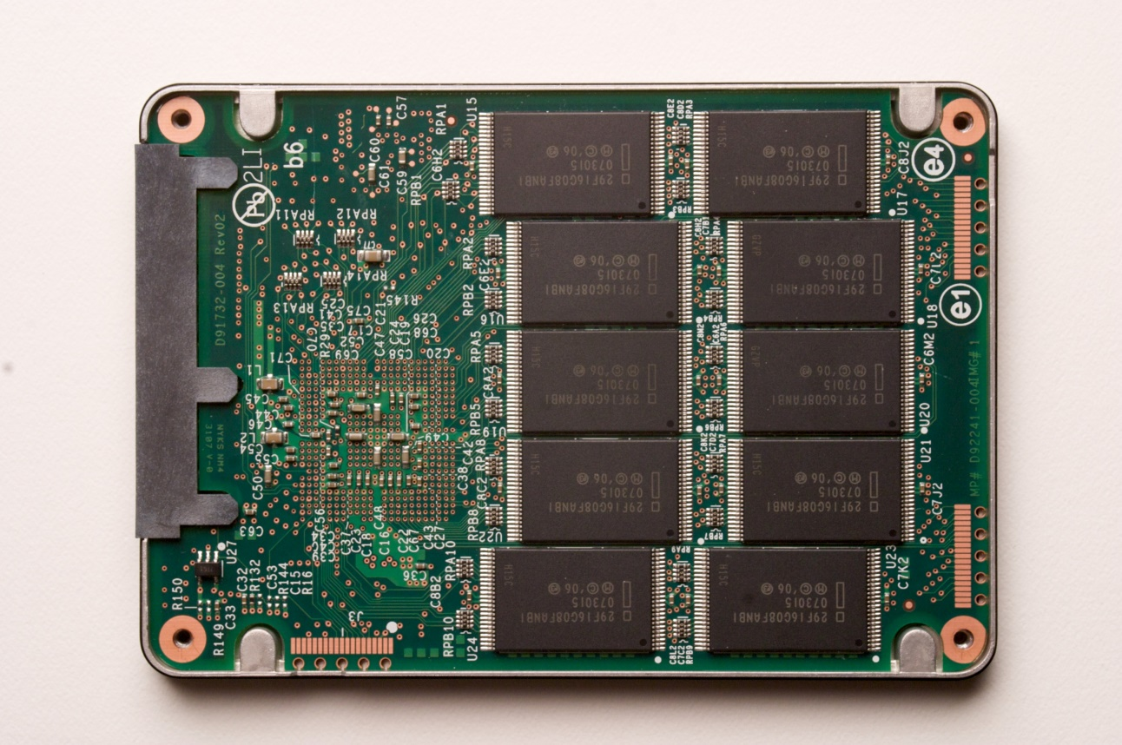
Solid State Drives
Non-volatile memory
NAND flash memory-based drives
High voltage is able to change the configuration of a floating-gate transistor
State of the transistor interpreted as binary data
Data is striped across all chips
Flash memory chip

Slide 24
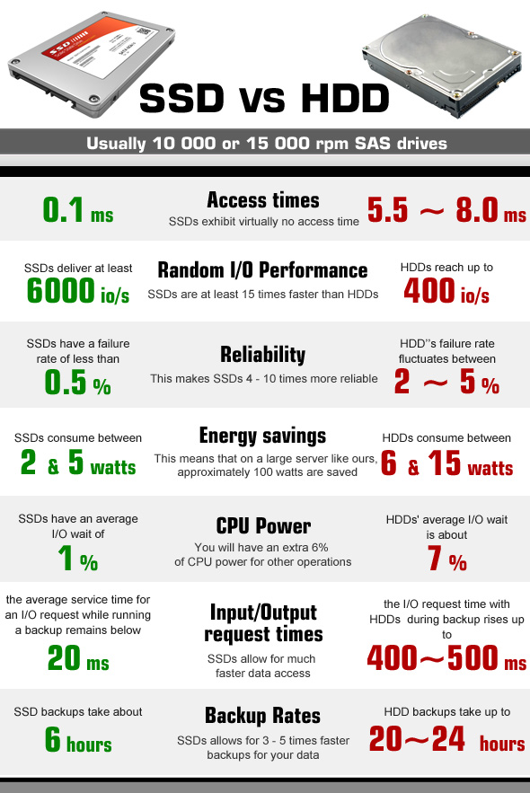
Solid State Drives (SSD)
A typical SSD has access speeds of 20 to 100 microseconds, which is nearly 100 times faster than a HDD
Cost: 16 TB SSD: USD 4000
VS 16 TB HDD: USD 400
Higher reliability as no moving parts
SDD failure rate: 1-3% per year
HDD failure rate: 2-9% per year
SDD limitation: Finite number of writes
3000 write cycles
Significantly low power consumption
Useful for
graphics or processing video processing
streaming videos in real-time - no-lag video streaming
In all modern computing machines
https://www.liquidweb.com/blog/ssd-vs-hdd/

Slide 25
What is inside a modern Desktop
Processors:
10th Gen Intel® Core™ i9-10900K processor(10-Core, 20M Cache, 3.7GHz to 5.3GHz) – 20 threads
Integrated GPU: Intel UHD Graphics 630
Discrete GPU: NVIDIA® GeForce® RTX 2070 SUPER™ 8GB GDDR6
Memory:
2TB 7200 rpm 3.5" SATA Hard Drive
256GB M.2 PCIe NVMe Solid State Drive
Intel Optane Memory - 32 GB, Storage Accelerator
128 GB, 4 x 32 GB, DDR4, 2666 MHz/2933 MHz, UDIMM, dual-channel
Chipset
DRAM Bus Width: 64-bits
Flash EPROM 32 MB
CS 305: Computer Architecture

Slide 26
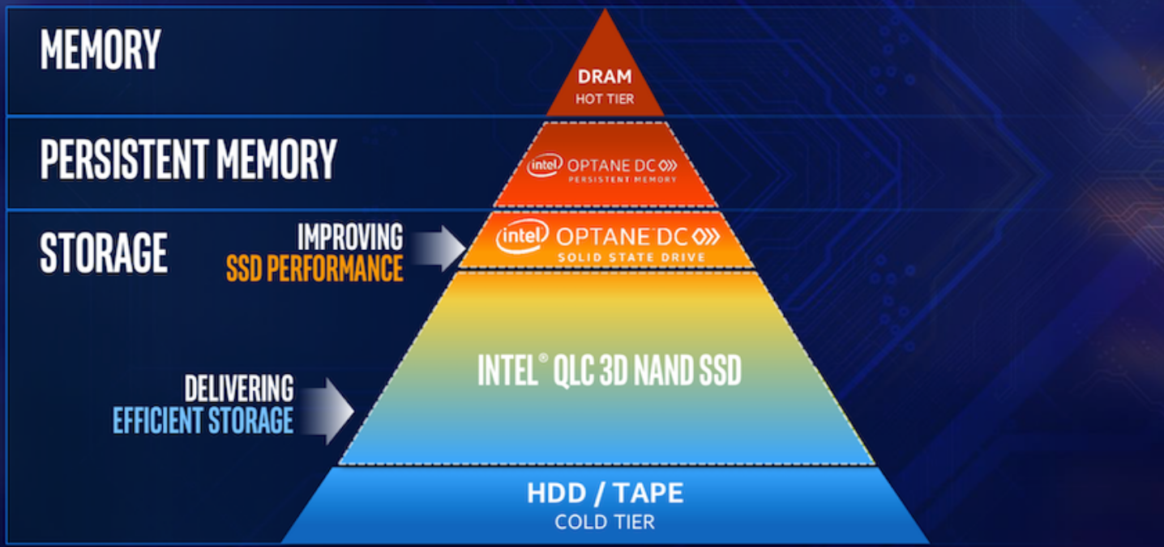
Intel Optane Persistent Memory (2019)
Non-volatile memory – that sits between MM and storage (HDD); Faster than SSD
https://www.storagereview.com/intel_optane_dc_persistent_memory_module_pmm

Slide 27
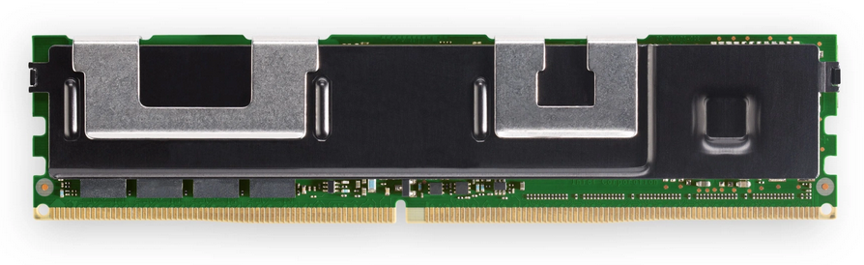
Intel Optane Persistent Memory (2019)
Based on 3D-XPoint Technology
Phase-Change Technology
What is this technology? How does it work?
Because it is significantly less expensive than DRAM and can have 15X – 20X the memory capacity per die
8GB vs. 128GB
Speeds at least 10X that of NAND (SSD Drive)
However, slower than DRAM (Main Memory)
An ideal ‘intermediary’ memory element

Slide 28
What is inside a modern Desktop
Processors:
10th Gen Intel® Core™ i9-10900K processor(10-Core, 20M Cache, 3.7GHz to 5.3GHz) – 20 threads
Integrated GPU: Intel UHD Graphics 630
Discrete GPU: NVIDIA® GeForce® RTX 2070 SUPER™ 8GB GDDR6
Memory:
2TB 7200 rpm 3.5" SATA Hard Drive
256GB M.2 PCIe NVMe Solid State Drive
Intel Optane Memory - 32 GB, Storage Accelerator
SDRAM (Synchronous DRAM): 128 GB, 4 x 32 GB, DDR4, 2666 MHz/2933 MHz, UDIMM, dual-channel (Main Memory)
Chipset
DRAM Bus Width: 64-bits
Flash EPROM 32 MB
CS 211: Computer Architecture
Notes:
Synchronous random access memory (SDRAM) is the same as DRAM except that regular DRAM is asynchronous. Synchronous random access memory stays synchronized with the computer's clock which allows greater efficiency in storing and retrieving data compared to asynchronous DRAM
DDR4 : double data rate 4

Slide 29
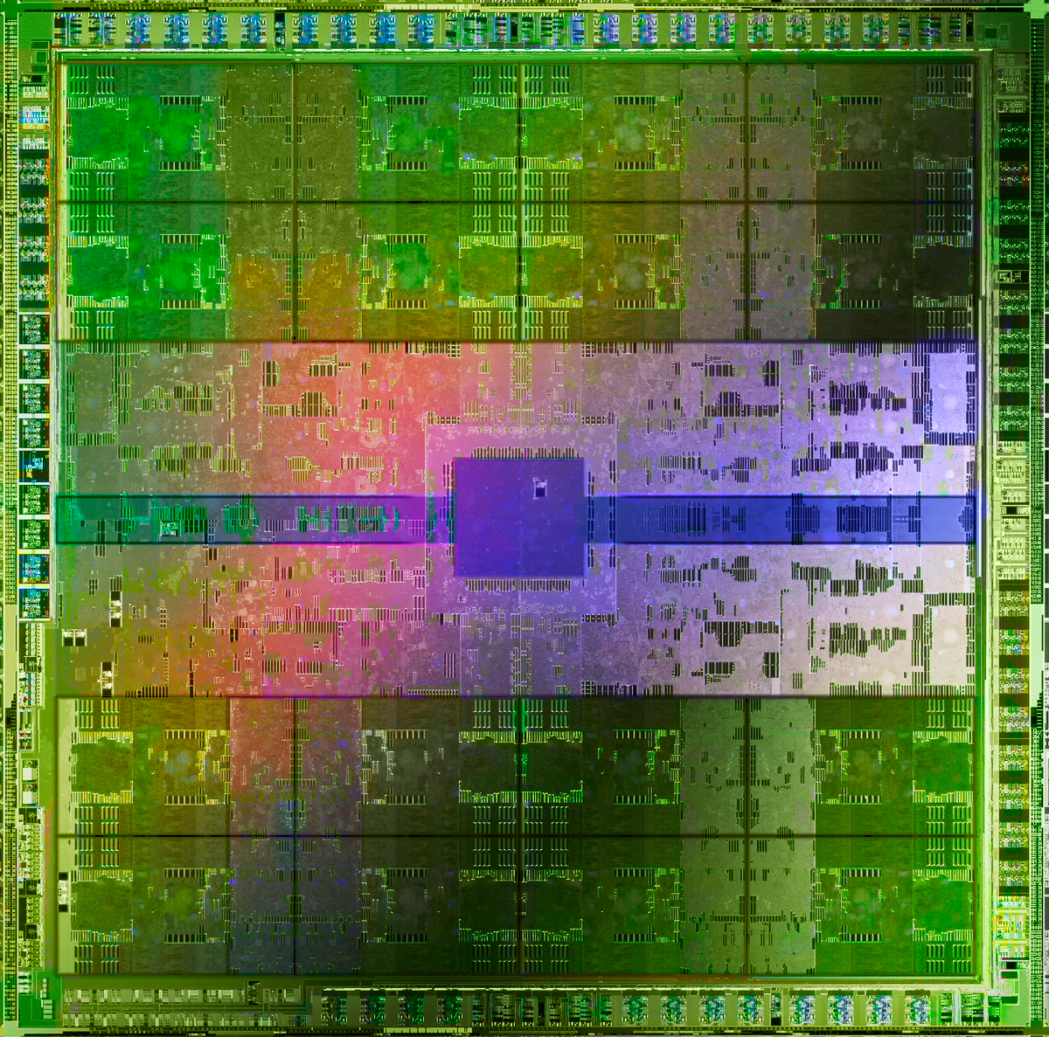
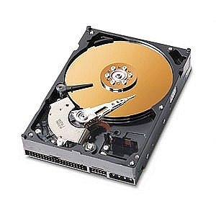
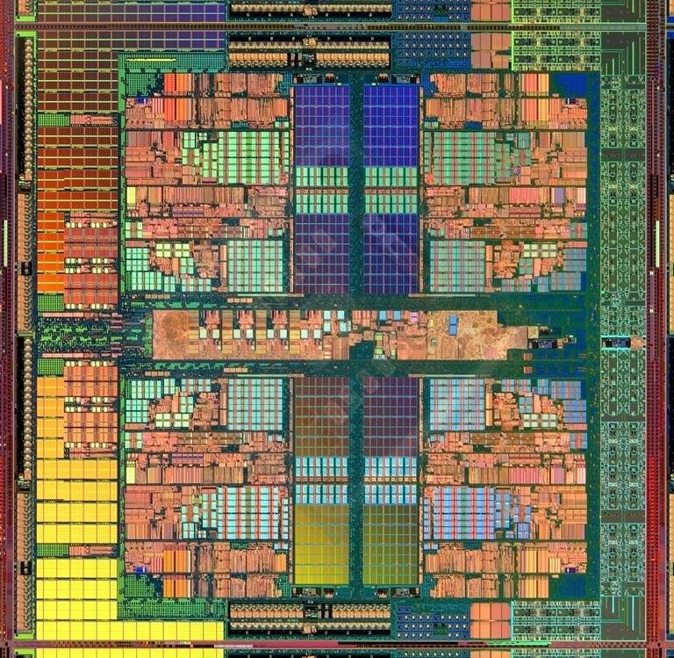
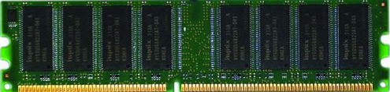
Main Memory (Volatile + Non-volatile)
GPUs
Processors
and caches
Main Memory
Storage (SSD/HDD)
Most computers use Volatile Memory: DRAM (mainly Synchronous DRAM)
SDRAM Speed: 60-100 ns
Advantages of DRAM: Simplicity (only one Transistor and one capacitor); High density
Notes:
SRAM - four or six transistors per bit
SRAM – Used primarily in cache

Slide 30
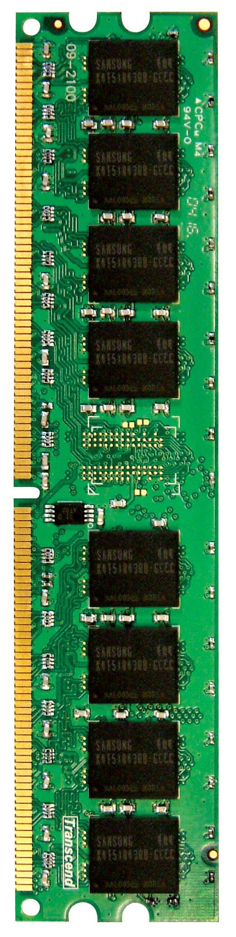
Main Memory: DRAM in the System
Multi-Core
Chip
CORE 0
L2 CACHE 1
CORE 1
L2 CACHE 0
SHARED L3 CACHE
DRAM INTERFACE
DRAM MEMORY CONTROLLER
DRAM BANKS
L2 CACHE 2
CORE 3
CORE 2
L2 CACHE 3
*Die photo credit: AMD Barcelona

Slide 31
What is inside a modern Desktop
Bus
Peripheral Component Interconnect Express (PCIe or PCI-E) – Gen 3.0
Network
Ethernet: 10/100/1000 Mbps
WLAN
WLAN: WiFi 802.11a/b/g
Wi-Fi 4 (WiFi 802.11n)
Wi-Fi 5 (WiFi 802.11ac)
Wi-Fi 6 (WiFi 802.11ax)
2.40 GHz/5 GHz
64-bit/128-bit WEP, AES-CCMP, TKIP
Bluetooth 5.1

Slide 32
Buses
CPU chip
Register file
ALU
System bus
Memory bus
Main
memory
Bus interface
I/O
bridge
PCI Bus
I/O bus
Expansion slots for
other devices such
as network adapters.
USB
controller
Graphics
adapter
Disk
controller
Mouse
Keyboard
Monitor
Disk

Slide 33
Ethernet, WiFi, Bluetooth
Ethernet – IEEE 802.5 standard
De facto LAN technology
Port speed: 10/100/1000 Mbps ; 48 bit MAC address; CSMA/CD protocol
Over cable and fiber
Inexpensive and mature technology
Easy to understand, implement, manage, and maintain
Wireless LAN – IEEE 802.11b
Extremely popular
CSMA based MAC
Data Rates up to 3.5 Gbps (for 802.11ax)
Bluetooth
Limited range, Limited speed up to 5 Mbps
Low power ; Popular in mobile and Laptop

Slide 34

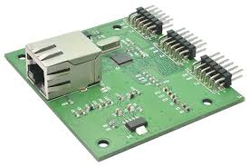
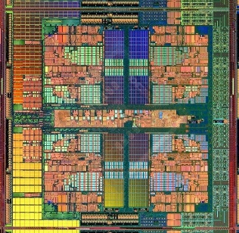
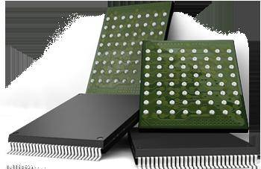
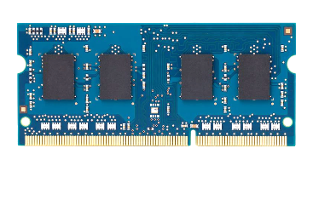
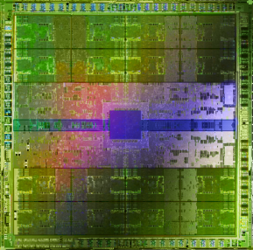
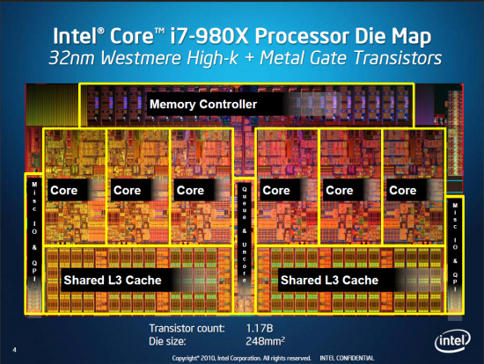
Computer Architecture Today – Lecture Summary
High Speed Network
Hybrid Main Memory
Heterogeneous
Processors and
Accelerators
Persistent Memory/Storage
General Purpose GPUs

Slide 35
References
Dell Desktops: www.dell.com
Lecture presentation, Lecture 21a, Memory Organization and Memory Technology, Prof Onur Mutlu, ETH Zürich, Spring 2020
Blog, Donald Firesmith, Multicore processing, https://insights.sei.cmu.edu/sei_blog/2017/08/multicore-processing.html
https://software.intel.com/content/www/us/en/develop/articles/software-techniques-for-shared-cache-multi-core-systems.html?wapkw=smart+cache
https://www.liquidweb.com/blog/ssd-vs-hdd/

Slide 36
Advantages of Multicore Processing
Energy Efficiency
Overcome heat generation – Refer Moore’s law
When low load, some processors can run at low frequency or may be switched off
True Parallelism
Higher Performance
Isolation may improve
Spatial Isolation
Temporal Isolation
Software running on one core may not affect the software on the other core
Reliability and Robustness

Slide 37
Issues with Multicore Processing
Shared Resources
Cache, Buses, Memory controller, I/O devices, Network
May cause interference
Security Issues
Non-determinism
Analysis Difficulty
If not properly fine tuned, it can have adverse effect on
Performance
Real-time guarantees
https://insights.sei.cmu.edu/sei_blog/2017/08/multicore-processing.html

Slide 38
PCI: Peripheral Component Interconnect Bus

